Slide 1
The Data Link Layer and Framing

Slide 2
Purpose
Main aim:
To deliver frames of information over a single link
Handles transmission errors
Regulates flow of data
5 | Application
4 | Transport
3 | Network
2 | Data Link
1 | Physical

Slide 3
Data Link Layer Design Issues
The physical layer delivers bits of information to and from data link layer.
The functions of Data Link Layer are:
Providing a well-defined service interface to the network layer.
Dealing with transmission errors.
Regulating the flow of data so that slow receivers are not swamped by fast senders.
Data Link layer (Sender side)
Takes the packets from Network layer, and
Encapsulates them into frames

Slide 4
Headers / Payloads…
Layer 3 Packet |  | L3 Header | L3 Payload
Layer 2 Frame | L2 Header | L2 Payload |  | L2 Trailer
On the link | L2 Header | L3 Header | L3 Payload | L2 Trailer
L2 Payload == A L3 Packet
L2 Trailer: Also called “Footer” or “Tail”
In other words:
“A frame carries a packet inside it, but it doesn’t care what the packet actually is”

Slide 5
Possible Services Offered
Unacknowledged connectionless service.
Frames sent without error recovery
e.g. Ethernet
Acknowledged connectionless service.
Frame sent with retransmissions if needed
e.g. WiFi (IEEE 802.11)
Connection-oriented service.
Connection is set-up
e.g. Bluetooth in connected mode

Slide 6
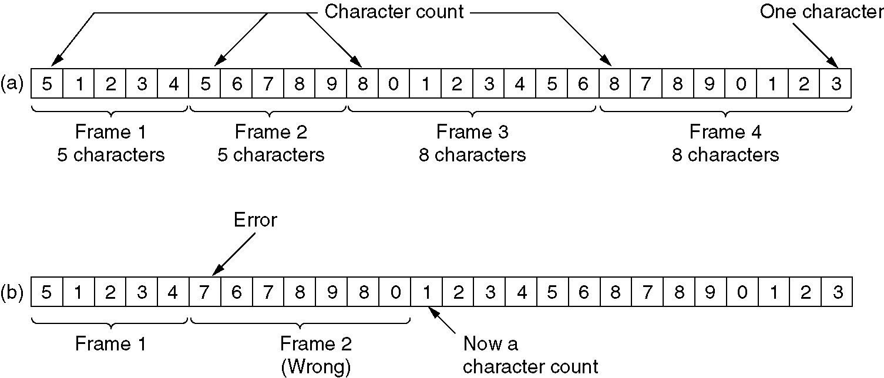
Framing with byte count
Each frame begins with byte count
Difficult to re-synchronise
Examples (a) Without errors. (b) With one error.

Slide 7
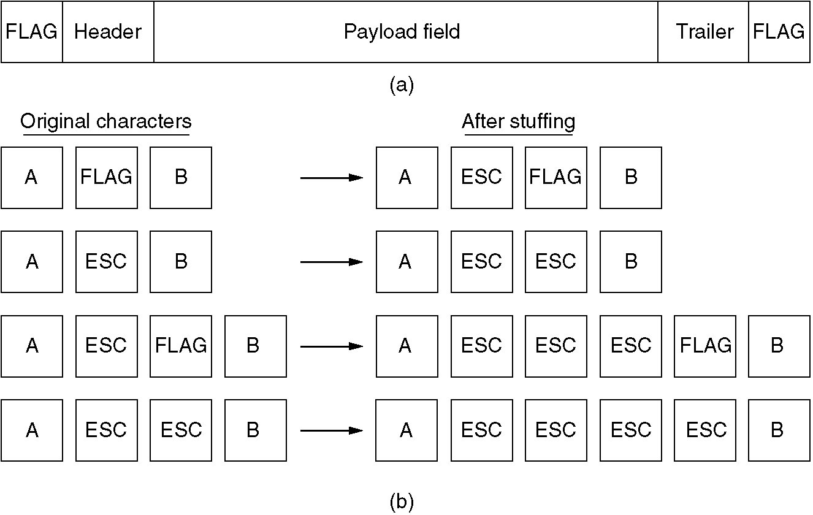
Byte stuffing
FLAG byte delimits frames (marks start & end)
FLAG must be ESCaped when appearing in the frame
Why ESCape the ESC?
(a) A frame delimited by flag bytes.
(b) Four examples of byte sequences before and after stuffing.

